Slide 1
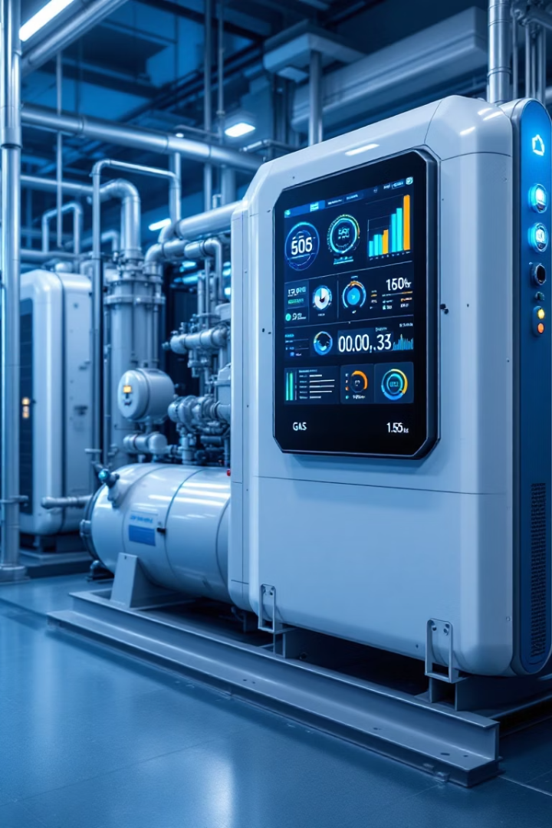
Maintelli: Predictive Maintenance for Compressors
Deep learning approach to predict failures in multistage centrifugal plant compressors

Slide 2




Project Overview
Team
Goal
Amal AlMukhlal, Hibah AlMashhad, Najla AlKhaldi
Minimize downtime, improve efficiency
Method
LSTM model to estimate remaining useful life

Slide 3



The Problem
Traditional Maintenance
Fixed intervals or manual checks
Unexpected Failures
Heavy losses from downtime
Unused Data
Valuable sensor data not utilized

Slide 4





Our Approach
Data Simulation
Realistic sensor data for compressors
Preprocessing
Cleaning, normalization, window structuring
LSTM Model
Deep learning for sequential data
Evaluation
Accuracy, precision, recall, F1-score

Slide 5












Data Features
Pressure
Temperature
Suction and discharge (PSI)
Machine/environment (°C)
Motor Current
Vibration
Amperes
Level (mm/s)
Operational Hours
Flow Rate
Cumulative time
Cubic meters/hour

Slide 6
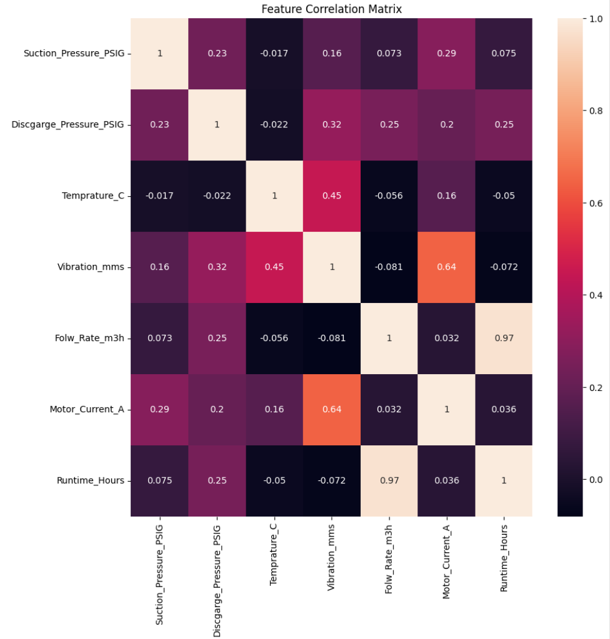
Feature Selection:
Correlation analysis is performed to identify and remove highly correlated features, preventing redundancy and potential issues caused by multicollinearity.

Slide 7
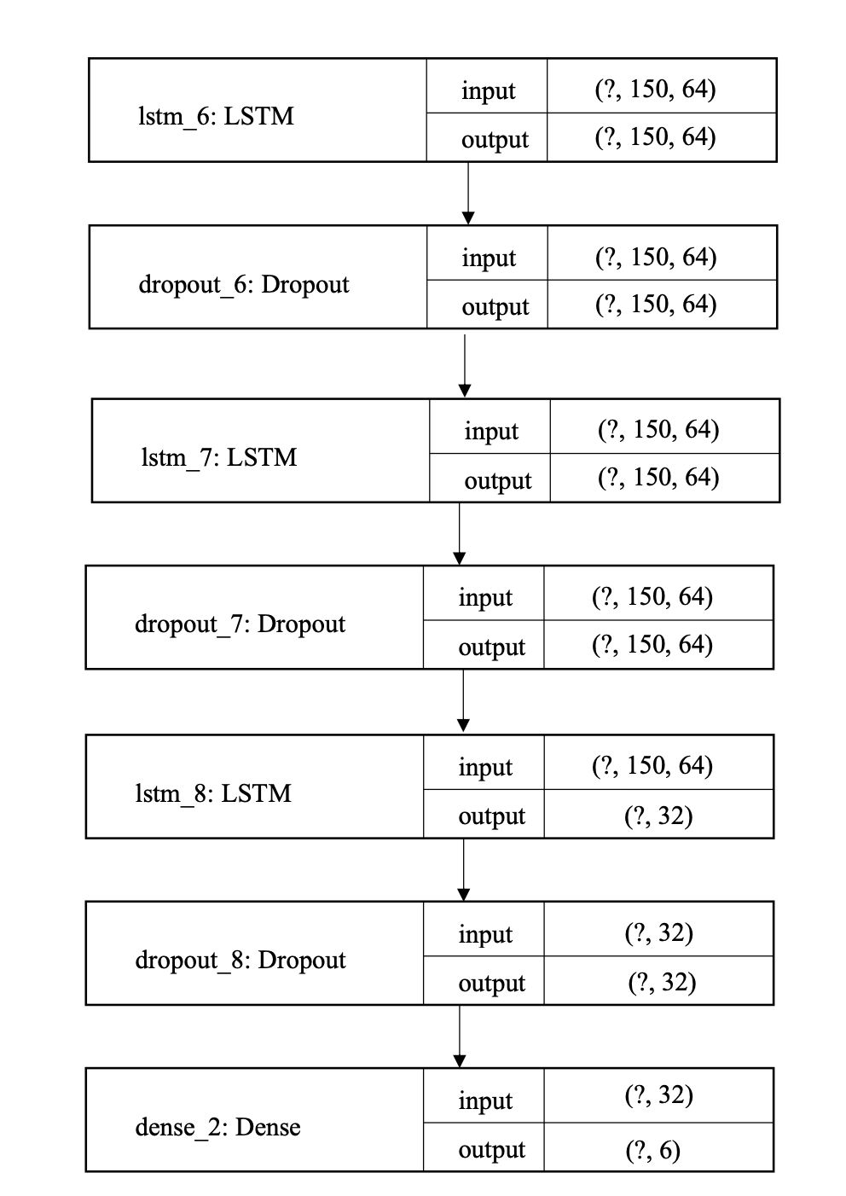
Model Architecture:
Three LSTM layers
Dropout layers are added after each LSTM layer
Dense layer with the same number of neurons as the input features is used as the output layer

Slide 8

Model Performance
100%
86%
Precision
Recall
Perfect positive predictions
High detection rate
92%
F1-Score
Strong overall performance

Slide 9
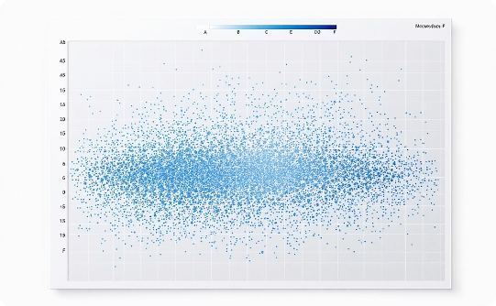
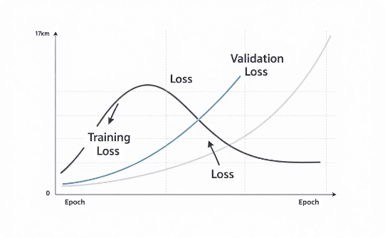
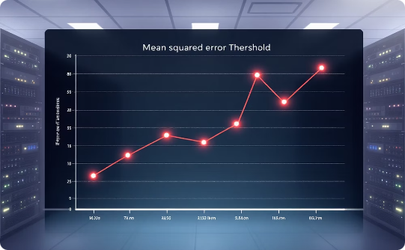
Results Visualization
Feature Correlation
Model Loss
MSE Visualization
Identifying relationships between sensors
Steady decrease over epochs
Failures exceeding 0.02 threshold

Slide 10
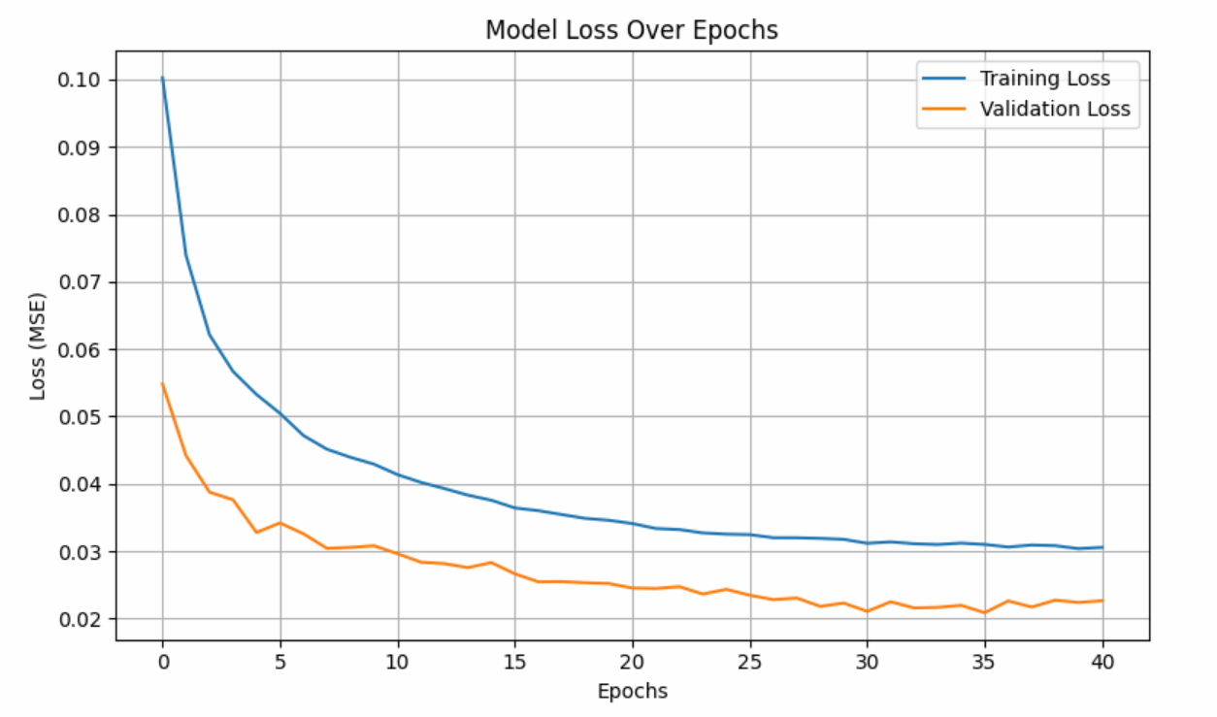
Results
Figure 3: model loss over epochs

Slide 11
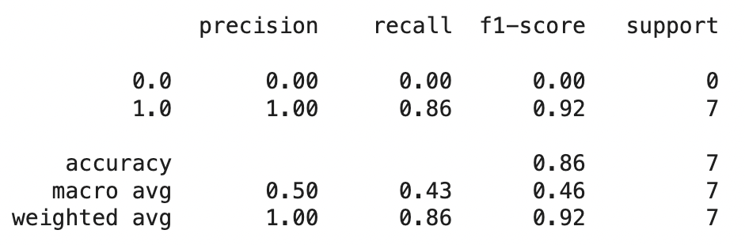
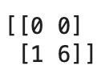
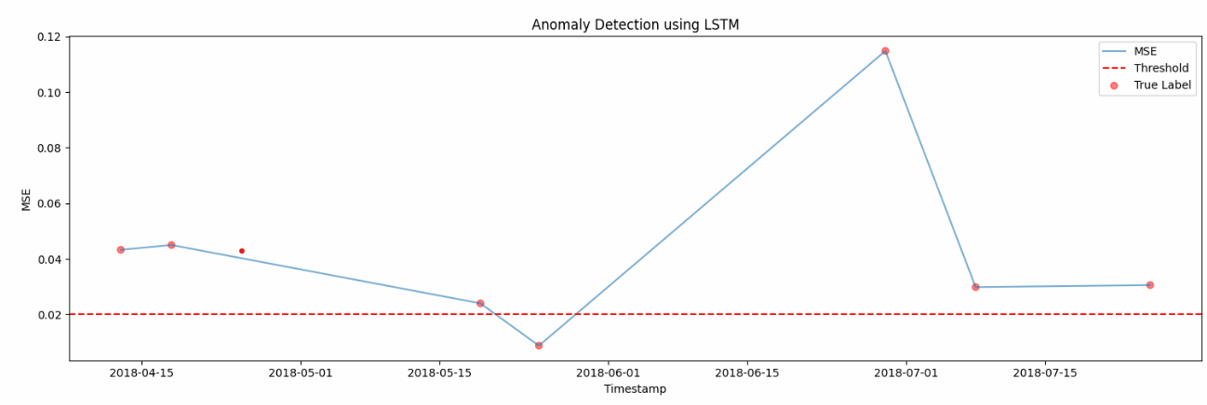
Results
Figure 4: classification report
Figure 5: confusion matrix
Figure 6: MSE visualization

Slide 12

Future Work
Live Testing
Real-time Streaming
Deploy with real industrial compressor data
Implement in streaming environments
Federated Learning
Enhance data privacy frameworks

